Slide 1
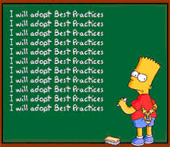
ISO/TC211 Ad hoc group on best practices for UML modelling

Slide 2

Vision
UML models that can be understood by both humans and machines

Slide 3
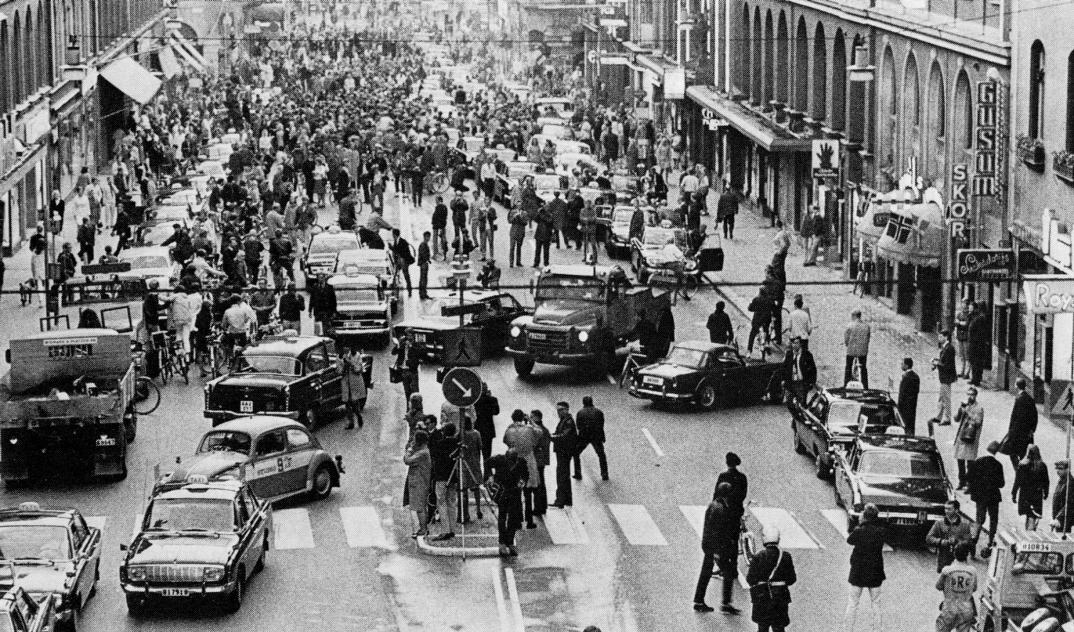
Progress report

Slide 4

Progress report
Call for members September 2014
Set up Livelink site
Investigating wiki oportunities
Initial discussions on subjects to include
Started preliminary wiki on Github

Slide 5
Preliminary plan
Before the meeting in Shenzhen:
Mail discussions on how to work
Mail and project place discussions on issues to include in the work
Physical meeting in Shenzhen
After the meeting in Shenzhen:
Starting to establish wiki
Describing specific issues
Mostly mail discussionss, web meetings when needed
Physical meeting in May/June 2015 (ISO/TC211 meeting week)
Next: We should continue the work up to the next meeting week in October/November 2015, but this is up to the plenary to decide

Slide 6
Result presentation – wiki site
OGC Internal
https://portal.opengeospatial.org/wiki/UMLdwg/WebHome
Login to view and edit
OGC External
http://external.opengeospatial.org/twiki_public/GML/WebHome
Open to view, login to edit
ISO TC/211 Wiki
To be discussed at AG Outreach
GitHub
https://github.com/ISO-TC211/UML-Best-Practices/wiki

Slide 7
Topics to include (overview)
Headlines
Basic UML
Modelling and design best practices
Relevant rules from standards
Implemetation issues
Level of abstraction
Conceptual models vs domain models vs application schemas vs implementation models

